Slide 1
Machine Comprehension using match-LSTM and Answer-Pointer
Akhil Nair
Ramkishan Panthena
GitHub: Machine-Comprehension-using-SQuAD-Dataset

Slide 2
In meteorology, precipitation is any product of the condensation of atmospheric water vapor that falls under gravity. The main forms of precipitation include drizzle, rain, sleet, snow, graupel and hail... Precipitation forms as smaller droplets coalesce via collision with other rain drops or ice crystals within a cloud. Short, intense periods of rain in scattered locations are called “showers”.
What causes precipitation to fall?
gravity
Locate. Reason. Answer
Challenging task for machines which requires: Understanding of Natural Language

Slide 3
Goal
The goal of our project is to implement a machine comprehension system
Adopt Match LSTM and Answer Pointer model developed by (Wang & Jiang)
Dataset
The benchmark dataset we use is The Stanford Question Answer dataset
The dataset consists of passages from 536 Wikipedia articles
Q&A created by humans through crowdsourcing making it realistic
Each passage has around 5 questions, resulting a total of 107K question answer pair

Slide 4
Preprocessing
Tokenize passages, questions and answers to create vocabulary
Vocabulary consists of 115K unique words
Sort Vocabulary to assign token-ids
Vocabulary tokens embedded with pretrained glove vectors
Tokens in passages and questions were replaced with token-ids
A answer span file is created which contains the start and end token location

Slide 5
Model Training
Build and train our model using tensorflow
Input feed to our model is given in batches of 32
Fix sequence length in our batch by zero padding

Slide 6
Why LSTMs?
Predict the next word based on the previous set of words
Sometimes recent information is enough to predict the next word
  The clouds are in the ____ (sky)
  I grew up in France. <sent> <sent>.. I speak fluent _____ (French)
We need the context from further back to predict the word you are looking for
LSTMs are capable of holding such long-term dependencies

Slide 7
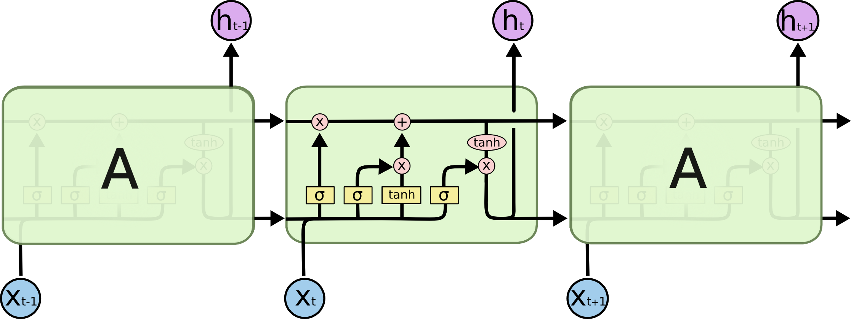
LSTMs
A repeating module in an LSTM layer

Slide 8
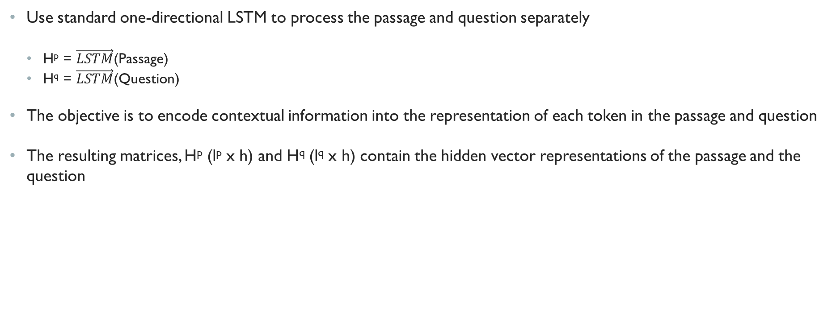
LSTM – Preprocessing Layer
Use standard one-directional LSTM to process the passage and question separately
  H^{p} = $\vec{LSTM}$(Passage)
  H^{q} = $\vec{LSTM}$(Question)
The objective is to encode contextual information into the representation of each token in the passage and question
The resulting matrices, H^{p} (l^{p} x h) and H^{q} (l^{q} x h) contain the hidden vector representations of the passage and the question

Slide 9
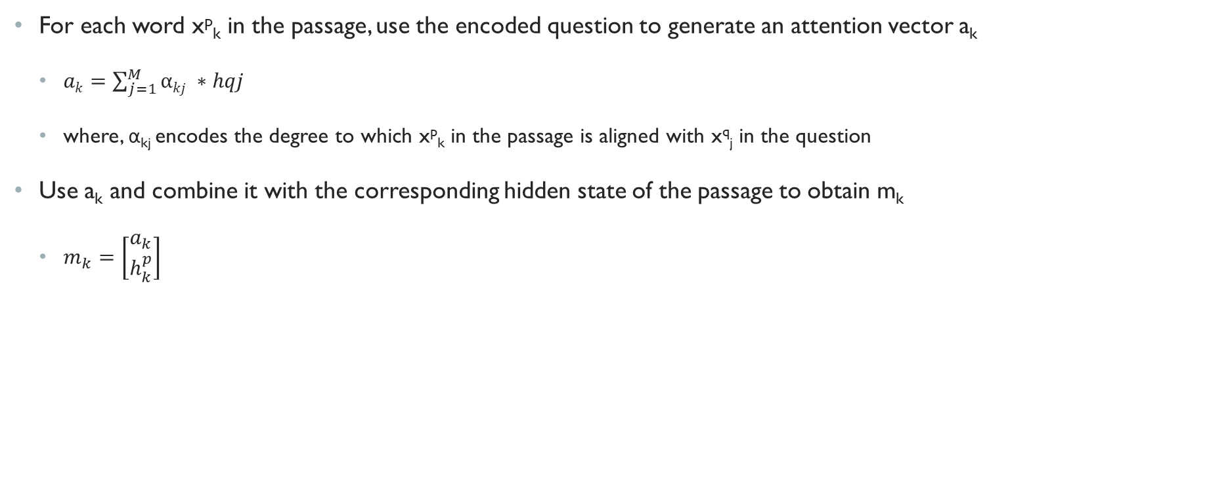
Match LSTM Layer
For each word x^{p}_{k} in the passage, use the encoded question to generate an attention vector a_{k}
  $ak=\sum_{j=1}^{M}{αkj ∗hqj}$
  where, α_{kj} encodes the degree to which x^{p}_{k} in the passage is aligned with x^{q}_{j} in the question
Use a_{k} and combine it with the corresponding hidden state of the passage to obtain m_{k}
  $m_{k}=\left[\begin{matrix}a_{k} \\ h_{k}^{p}\end{matrix}\right]$

Slide 10
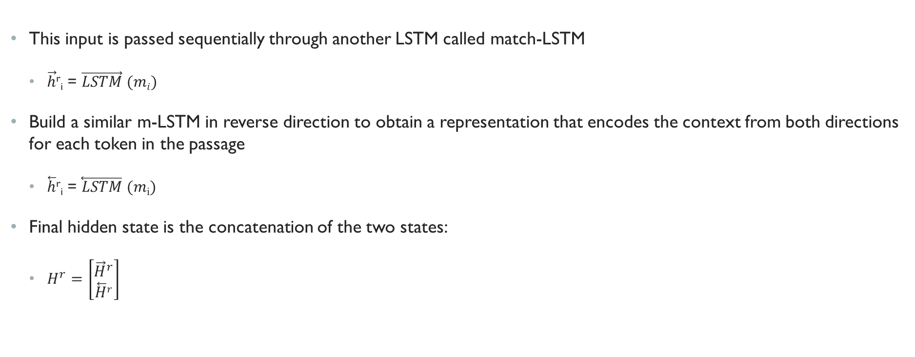
Match LSTM Layer (contd.)
This input is passed sequentially through another LSTM called match-LSTM
  $\vec{h}$^{r}_{i} = $\vec{LSTM} (mi)$
Build a similar m-LSTM in reverse direction to obtain a representation that encodes the context from both directions for each token in the passage
  $\overset{⃖}{h}$^{r}_{i} = $\overset{⃖}{LSTM} (mi)$
Final hidden state is the concatenation of the two states:
  $H^{r}=\left[\begin{matrix}{\vec{H}}^{r} \\ \overset{⃖}{H}r\end{matrix}\right]$

Slide 11
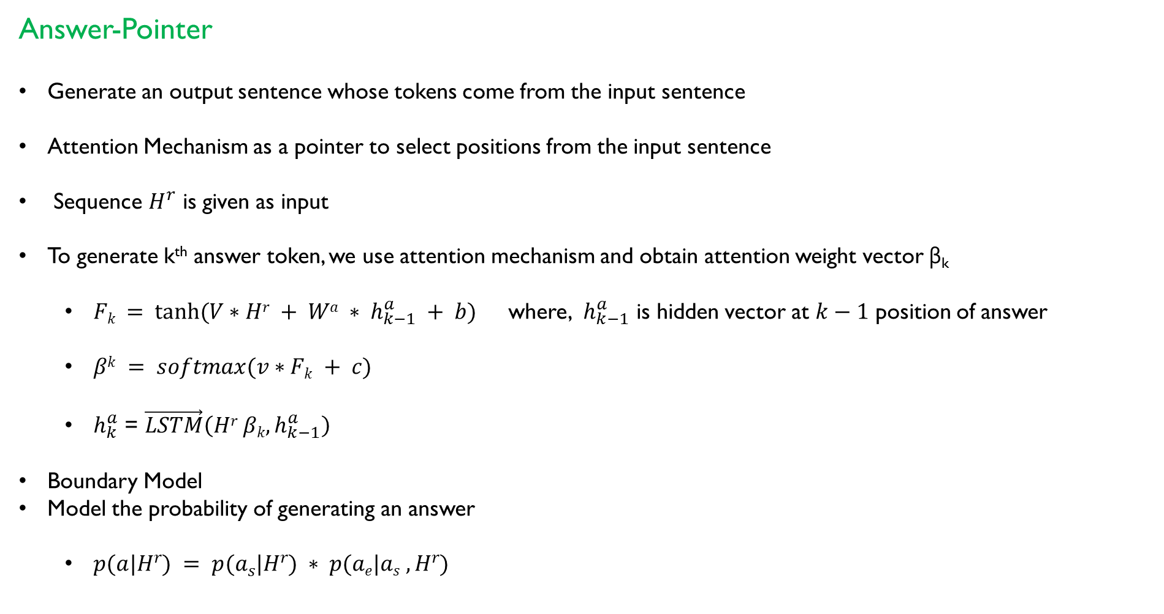
Answer-Pointer
Generate an output sentence whose tokens come from the input sentence
Attention Mechanism as a pointer to select positions from the input sentence
Sequence $H^{r}$ is given as input
To generate k^{th} answer token, we use attention mechanism and obtain attention weight vector β_{k}
  $Fk = tanh⁡(V∗Hr + Wa ∗ h_{k−1}^{a} + b)$ where, $h_{k−1}^{a}$ is hidden vector at $k−1$ position of answer
  $βk = softmax(v∗Fk + c)$
  $h_{k}^{a}$ = $\vec{LSTM}\left(Hr βk,h_{k−1}^{a}\right)$
Boundary Model
Model the probability of generating an answer
  $p(a|Hr) = p(as|Hr) ∗ p(ae|as , Hr)$

Slide 12
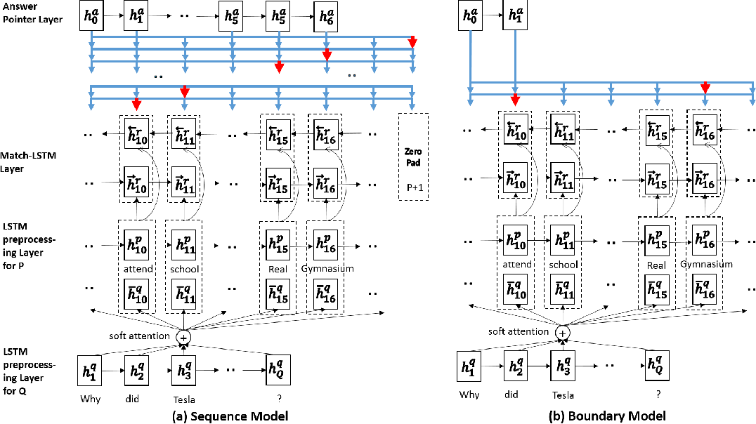

Slide 13
Model Evaluation
Exact Match metric is used to evaluate model accuracy
It matches the percentage of predictions that match the ground truth
Human performance Exact Match: 77.0%
Best model Exact Match: 81.685 %
Our model Exact Match (dev): 61%

Slide 14
References
Pranav Rajpurkar, Jian Zhang, Konstantin Lopyrev, and Percy Liang. SQuAD: 100,000+ questions for machine comprehension of text. In Proceedings of the Conference on Empirical Methods in Natural Language Processing, 2016.
Shuohang Wang and Jing Jiang. Learning natural language inference with LSTM. In Proceedings of the Conference on the North American Chapter of the Association for Computational Linguistics, 2016.
Wang, S. & Jiang, J. (2016) Machine Comprehension using Match-LSTM and Answer Pointer. arXiv: 1608.07905.
GloVe: Global Vectors for Word Representation - https://nlp.stanford.edu/pubs/glove.pdf
An introduction to LSTMs in Tensor Flow - https://www.youtube.com/watch?v=l4X-kZjl1gs
TensorFlow Neural Machine Translation Tutorial - https://github.com/tensorflow/nmt

